Slide 1

Data Science Fundamentals
Forecasting Basics with ARIMA

Slide 2
TIME SERIES COMPONENTS
Seasonal component refers to fluctuations in the data related to calendar cycles.
Trend component is the overall pattern of the series: Is the number increasing or decreasing over time?
Residual is part of the series that can't be attributed to other components.

Slide 3
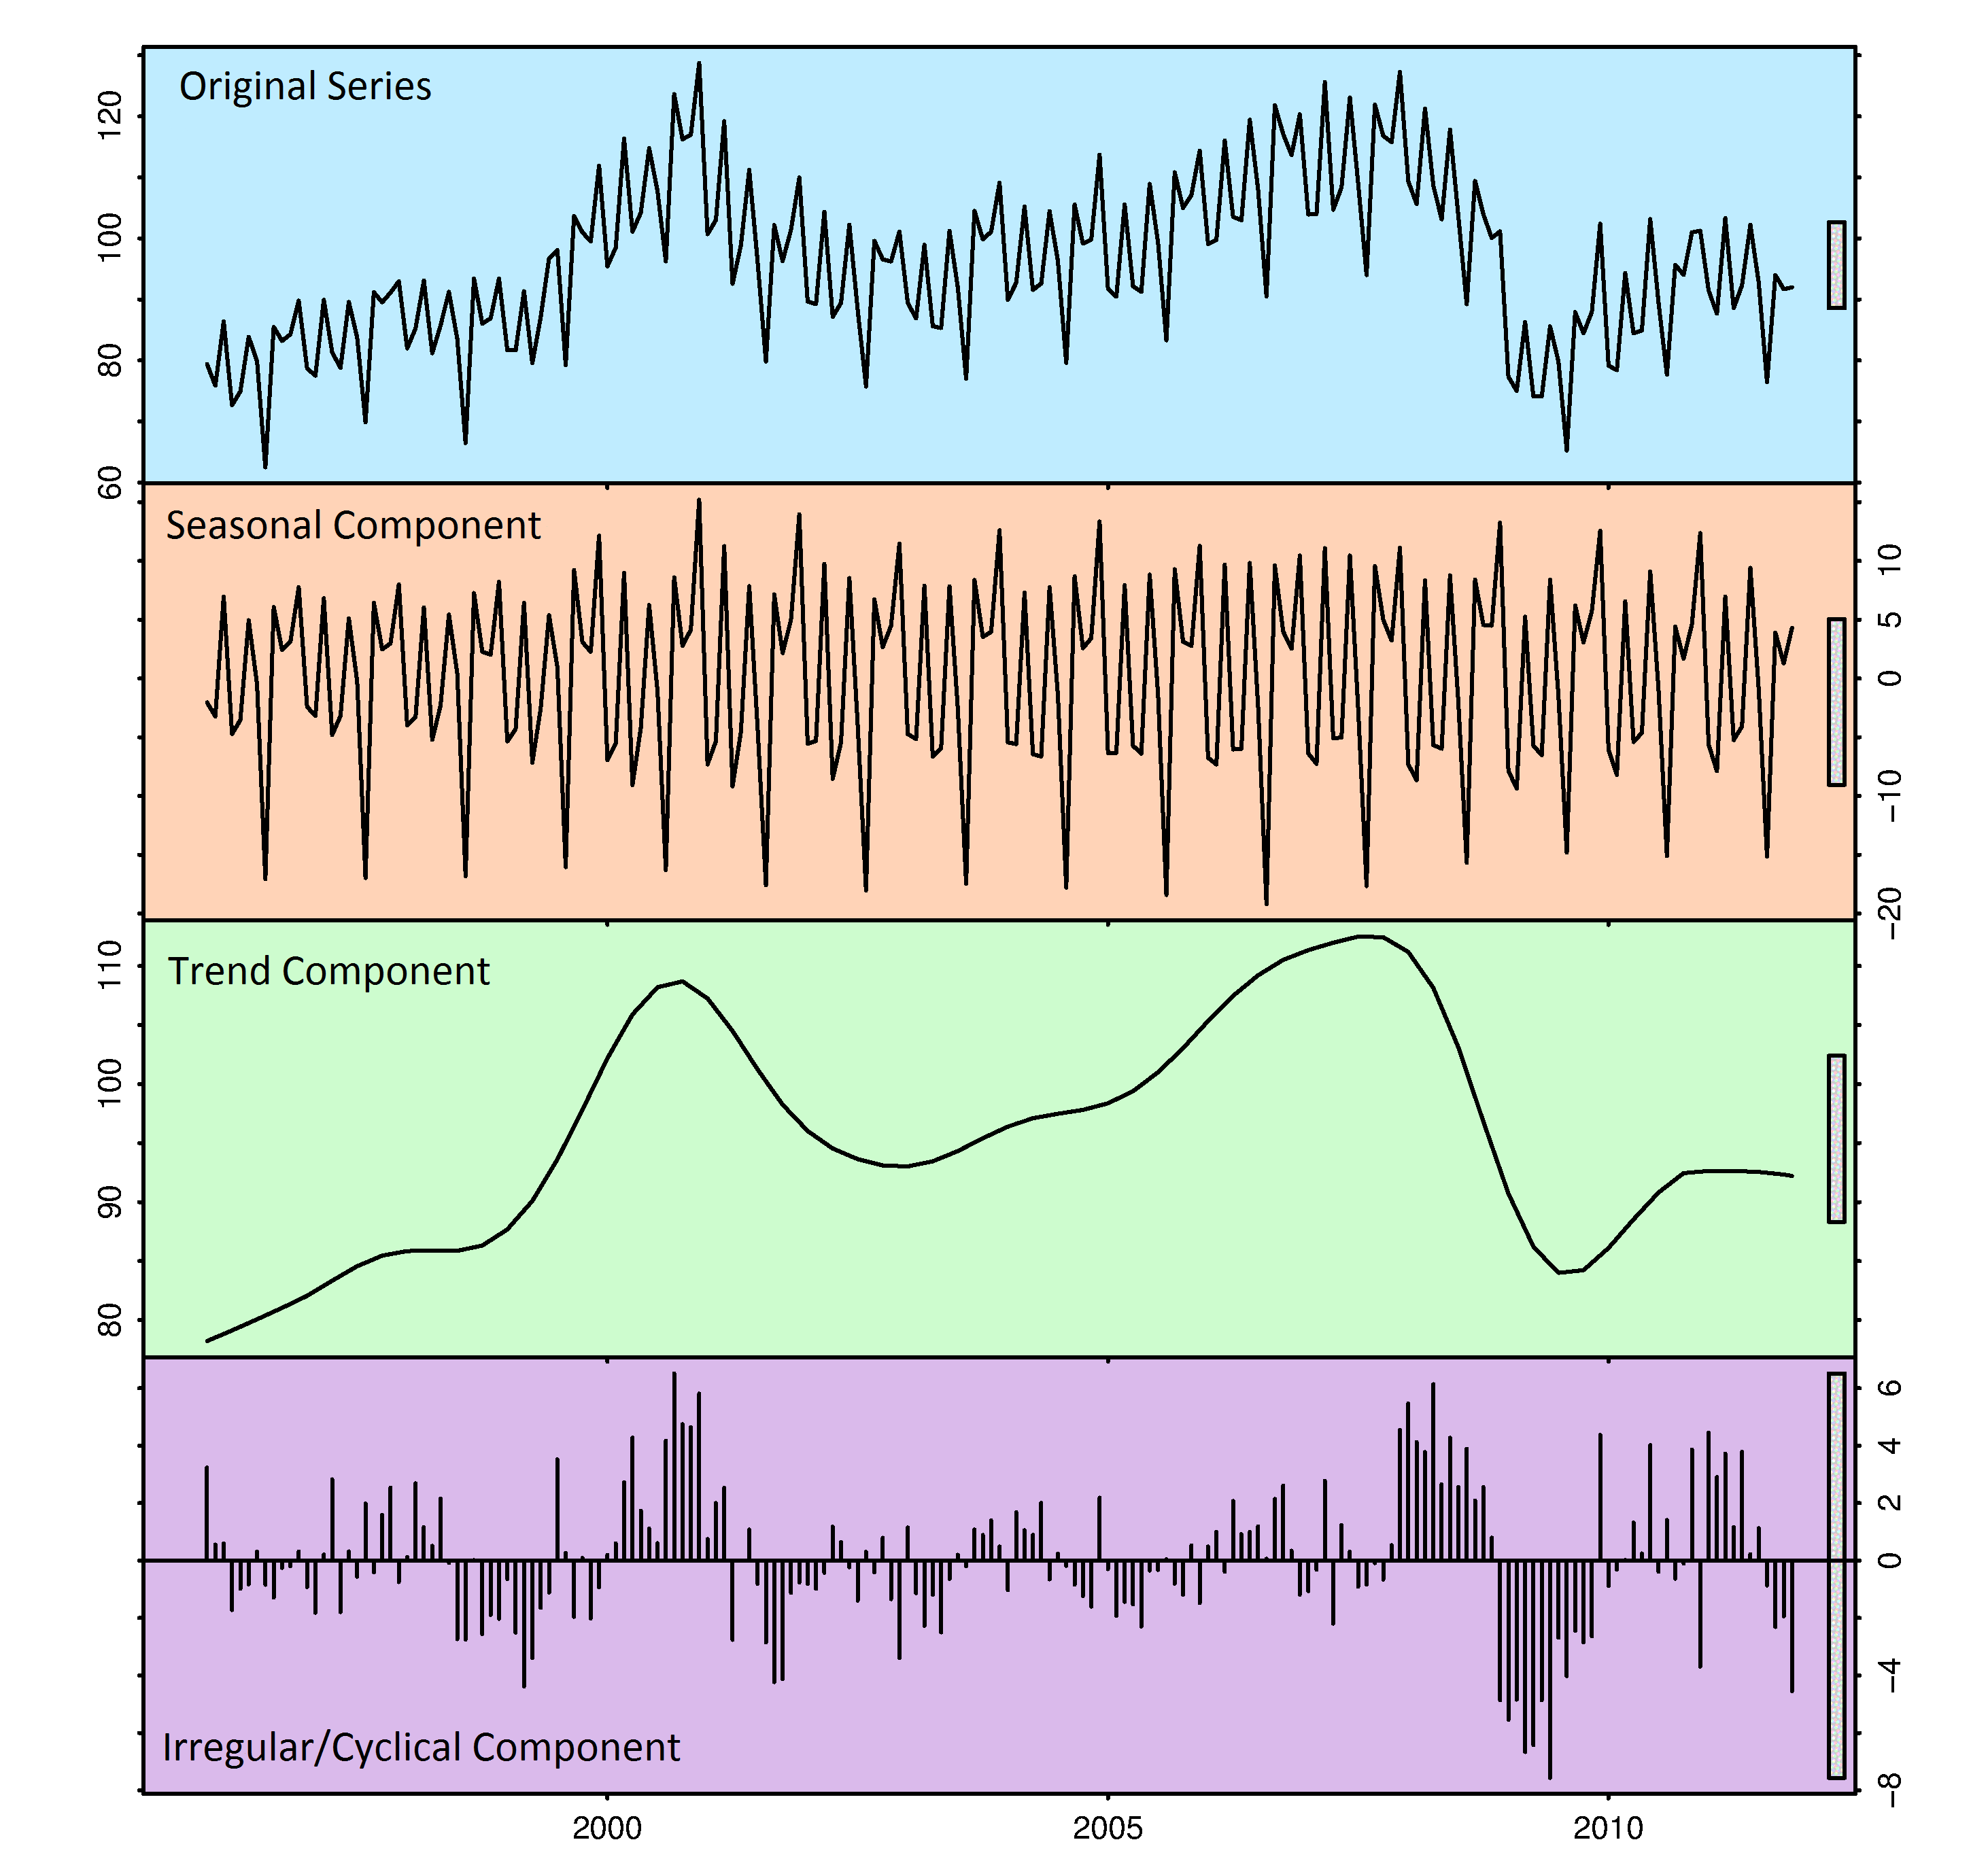

Slide 4
ARIMA – AutoRegressive Integrated Moving Average
ARIMA (p, q, r)
p = AR model, number of autoregressive terms
d = differencing to remove non-stationarity
q = MA model, number of lagged forecast errors in the prediction equation
ARIMA models work on the assumption of stationarity (i.e. they must have a constant variance and mean).
Notes:
Variance = sd²

Slide 5
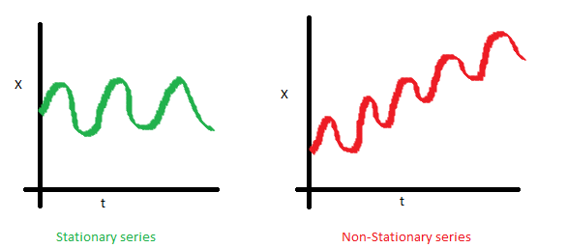
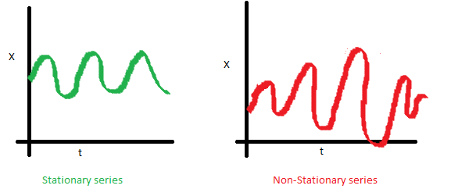
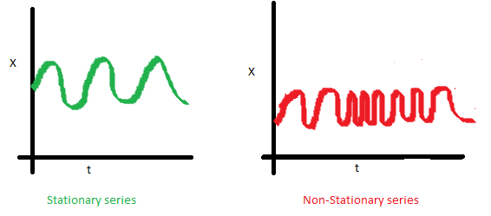
Constant MEAN
Constant VARIANCE
Constant COVARIANCE

Slide 6
DICKY-FULLER TEST
H0 = a unit root is present in the model (non-stationary)
H1 = a unit root is NOT present (model is stationary)

Slide 7
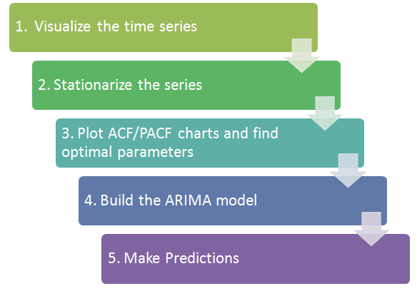
Notes:
diamonds

Slide 8
AUTO CORRELATION FUNCTION (ACF) & PARTIAL CORRELATION FUNCTION (PCF)
ACF = Total correlation between different lag function. Determines the MA process.
PACF = Partial correlation of a stationary time series with its own lagged values. Determines the AR process.

Slide 9
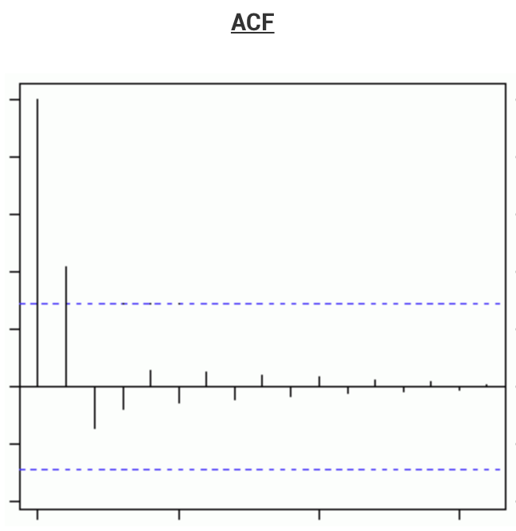
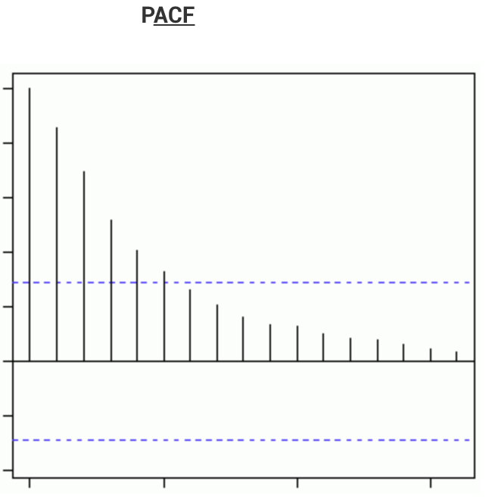
AUTO CORRELATION FUNCTION (ACF) & PARTIAL CORRELATION FUNCTION (PCF)

